Slide 1
Generic 2D Inverse Kinematics for Rovers
Miro Voellmy, 2019-04-09

Slide 2

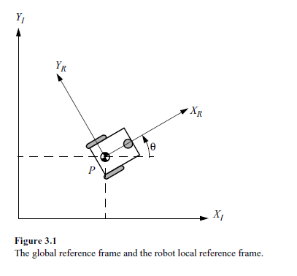
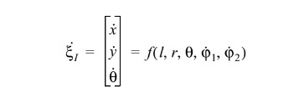


Robot Model
Position and orientation of rover in world
Linear and angular velocities of rover in world
Transformation from world to rover
Velocities transformed from world to rover

Slide 3
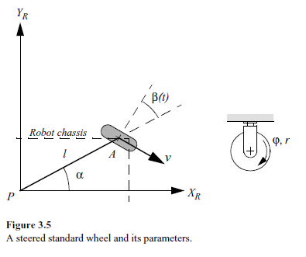
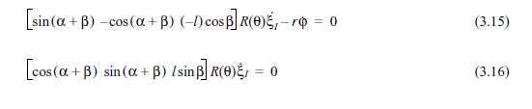
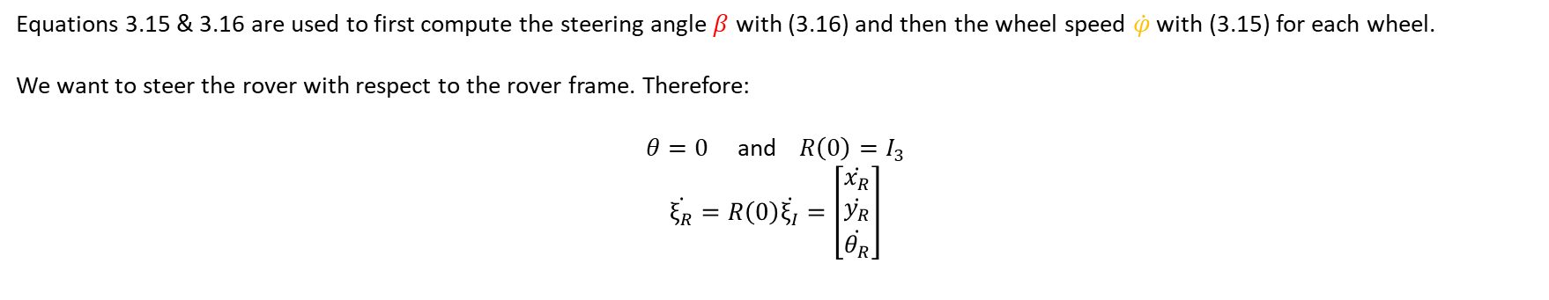
Steered Wheel Constraints
Rolling Constraint
No Sliding Constraint
Equations 3.15 & 3.16 are used to first compute the steering angle $β$ with (3.16) and then the wheel speed $\dot{φ}$ with (3.15) for each wheel.
We want to steer the rover with respect to the rover frame. Therefore:
$θ=0$ and $R\left(0\right)=I_{3}$
$$\dot{ξ_{R}}=R\left(0\right)\dot{ξ_{I}}=\left[\begin{matrix}\dot{x_{R}} \\ \dot{y_{R}} \\ \dot{θ_{R}}\end{matrix}\right]$$

Slide 4
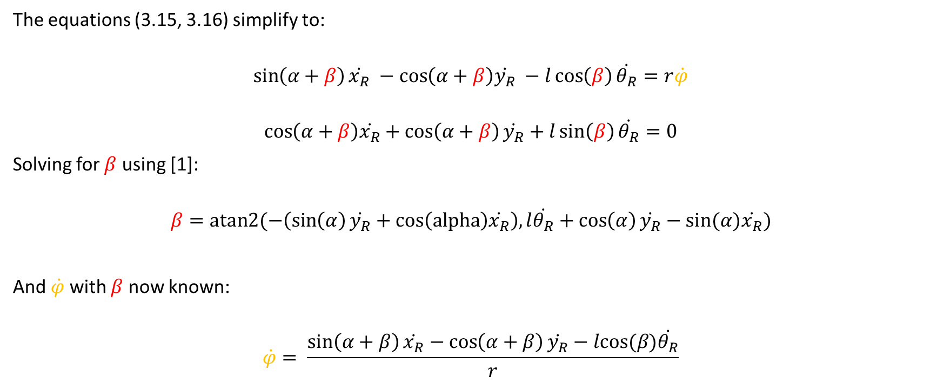
Steer Wheel Constraints
The equations (3.15, 3.16) simplify to:
$$\sin\left(α+β\right)\dot{x_{R}} −\cos\left(α+β\right)\dot{y_{R}} −l\cos\left(β\right)\dot{θ_{R}}=r\dot{φ}$$
$$\cos\left(α+β\right)\dot{x_{R}}+\cos\left(α+β\right)\dot{y_{R}}+l\sin\left(β\right)\dot{θ_{R}}=0$$
Solving for $β$ using [1]:
$$β=atan2(−\left(\sin\left(α\right)\dot{y_{R}}+cos\left(alpha\right)\dot{x_{R}}\right), l\dot{θ_{R}}+\cos\left(α\right)\dot{y_{R}}−sin⁡(α)\dot{x_{R}})$$
And $\dot{φ}$ with $β$ now known:
$$\dot{φ}= \frac{\sin\left(α+β\right)\dot{x_{R}}−\cos\left(α+β\right)\dot{y_{R}}−lcos⁡(β)\dot{θ_{R}}}{r}$$
[1]: $s\left(α+β\right)=s\left(α\right)c\left(β\right)+c\left(α\right)s\left(β\right)$ and $c\left(α+β\right)=c\left(α\right)c\left(β\right)−s\left(α\right)s(β)$

Slide 5






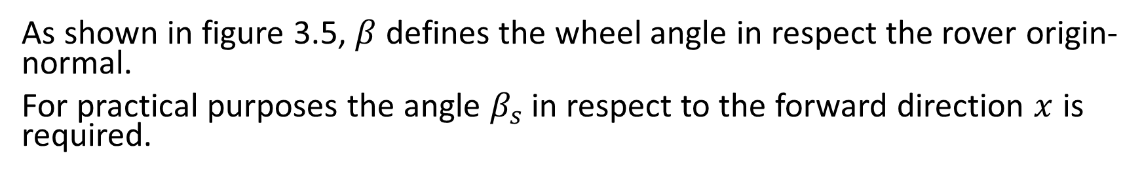









Steering Angle Corrections
As shown in figure 3.5, $β$ defines the wheel angle in respect the rover origin-normal.
For practical purposes the angle $β_{s}$ in respect to the forward direction $x$ is required.
$$β_{o}=\frac{π}{2} −α$$
$$β_{s}=β−β_{o}$$
$$β$$
$$α$$
$$β_{o}$$
$$β_{s}$$
$$β$$
$$β_{o}$$
$$Y_{R}$$
$$β$$
$$α$$
$$β=0$$
$$α$$
$$α$$
$$X_{R}$$

Slide 6
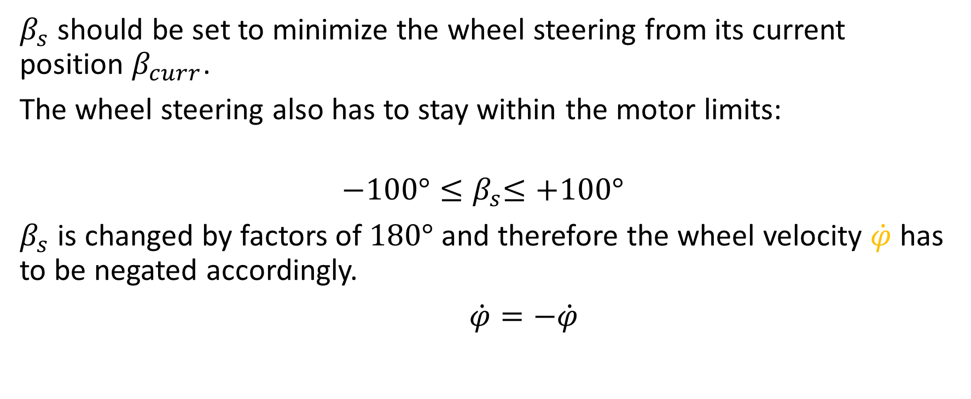
Steering Angle Requirements
$β_{s}$ should be set to minimize the wheel steering from its current position $β_{curr}$.
The wheel steering also has to stay within the motor limits:
$${−100°≤β}_{s}≤+100°$$
$β_{s}$ is changed by factors of $180°$ and therefore the wheel velocity $\dot{φ}$ has to be negated accordingly.
$\dot{φ}=−\dot{φ}$

Slide 7
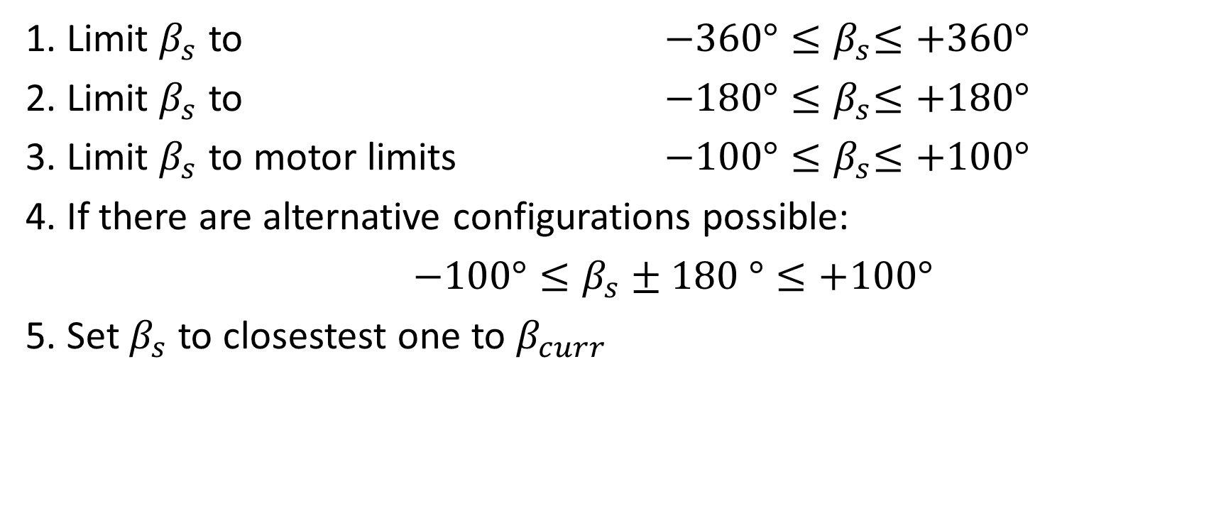
Steering Angle Correction Procedure
1. Limit $β_{s}$ to ${−360°≤β}_{s}≤+360°$
2. Limit $β_{s}$ to ${−180°≤β}_{s}≤+180°$
3. Limit $β_{s}$ to motor limits ${−100°≤β}_{s}≤+100°$
4. If there are alternative configurations possible:
$−100°≤β_{s}±180 °≤+100°$
5. Set $β_{s}$ to closestest one to $β_{curr}$

Slide 8













Steering Angle Correction Example
0.
$$β_{s}=620°$$
1.
$$β_{s}=260°$$
2.
$$β_{s}=80°$$
$$α$$
$$α$$
$$α$$
3.
$$β_{s}=80°$$
4.
$$β_{s}=80°$$
5.
$$β_{s}−100°$$
$$α$$
$$α$$
$$α$$
$$β_{curr}$$

Slide 9



Rolling and Sliding Constraints

